Slide 1


AI-Based Smart Virtual Assistant
Presented by
Roll No - 2275104
Supervisor
Dr. Kamakhya Narain Singh

Slide 2
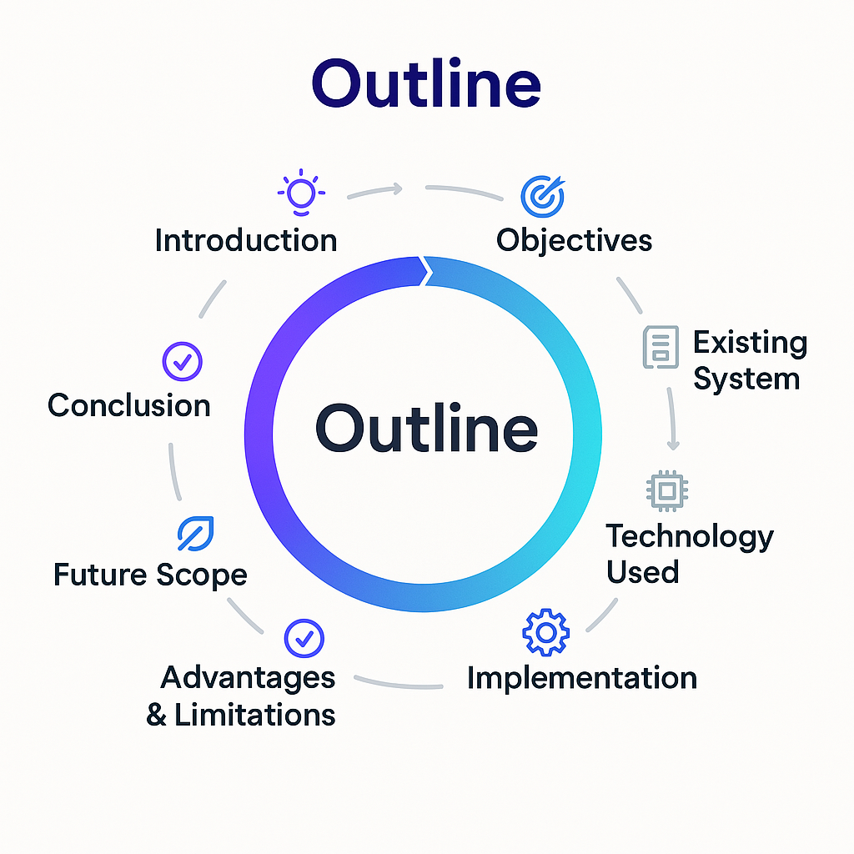
Outline
Introduction
Objectives
Existing System
Proposed System
Technology Used
Implementation
Testing & Results
Advantages & Limitations
Future Scope
Conclusion

Slide 3
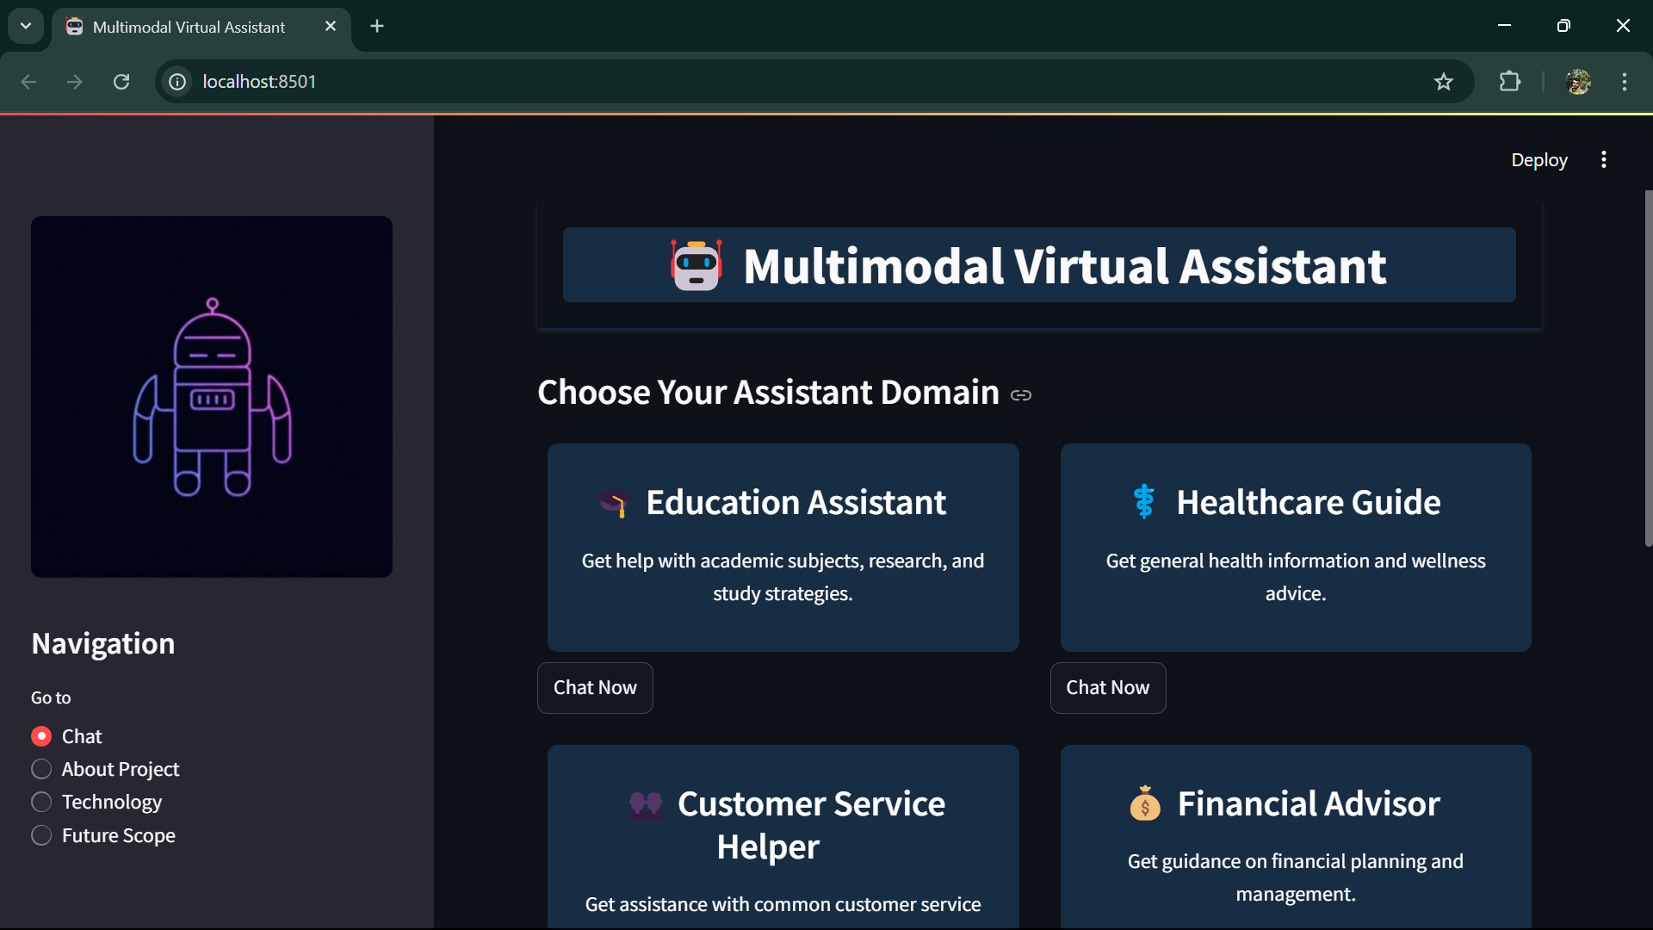
Introduction
AI is transforming how we interact with technology—think Siri or Alexa, but smarter!
This project: An AI-Based Smart Virtual Assistant built with Python, Streamlit, and Mistral API.
Goal: A web-based tool for real-time help with queries, summaries, and tasks.
Why it matters: Simplifies life for students, professionals, and beyond!

Slide 4
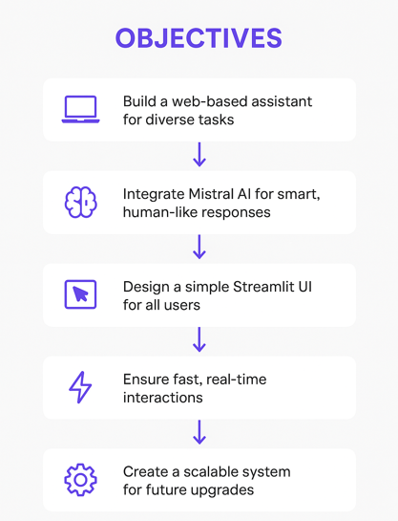
Objective
Build a web-based assistant for diverse tasks.
Integrate Mistral AI for smart, human-like responses.
Design a simple Streamlit UI for all users.
Ensure fast, real-time interactions.
Create a scalable system for future upgrades.

Slide 5
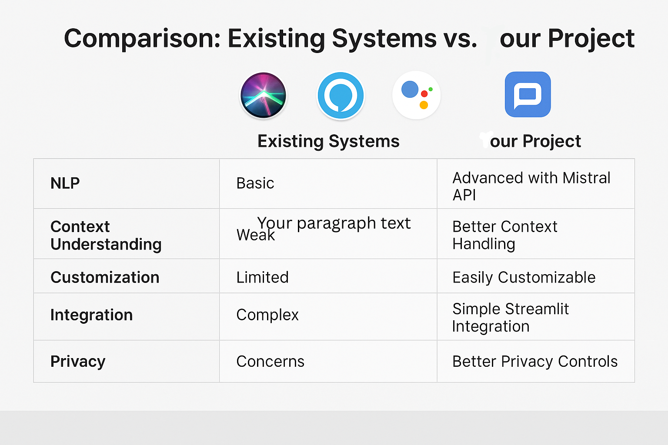
Existing system
Examples: Siri, Alexa, Google Assistant.
Features: Basic NLP, task-specific scripts.
Limitations:
Weak context understanding.
Limited customization.
Integration challenges.
Privacy concerns.

Slide 6
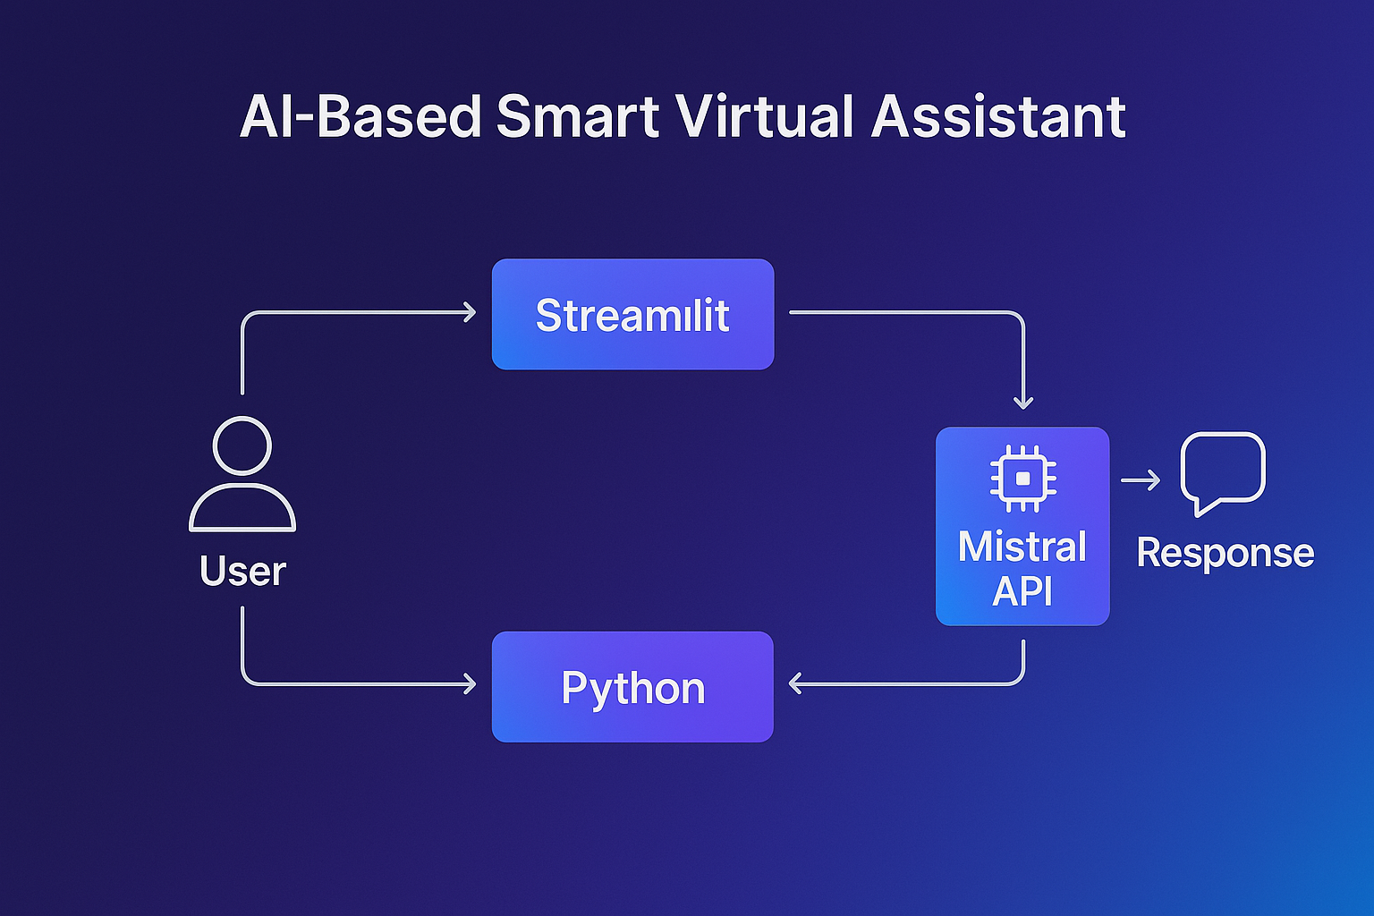
Proposed system
AI-Based Smart Virtual Assistant:
Smarter replies via Mistral API.
Multi-tasking: Answers, summaries, content generation.
Streamlit UI: Simple, web-based, accessible.
Secure & scalable design.
Solves: Context issues, rigid functionality, and more!

Slide 7
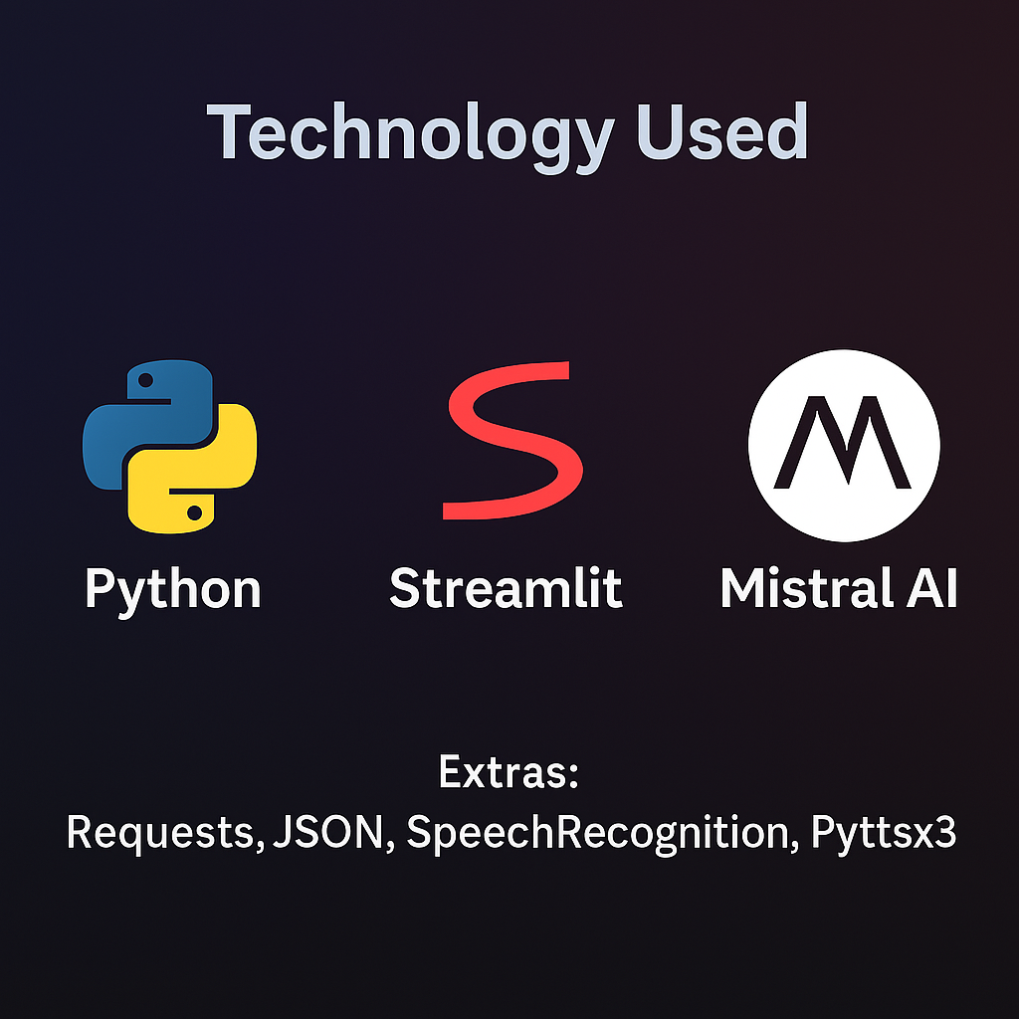
Technology Used
Python: Backend logic, versatile libraries.
Streamlit: Fast, interactive web UI.
Mistral API: Intelligent, natural responses.
Extras: Requests, JSON, (future: SpeechRecognition, Pyttsx3).

Slide 8
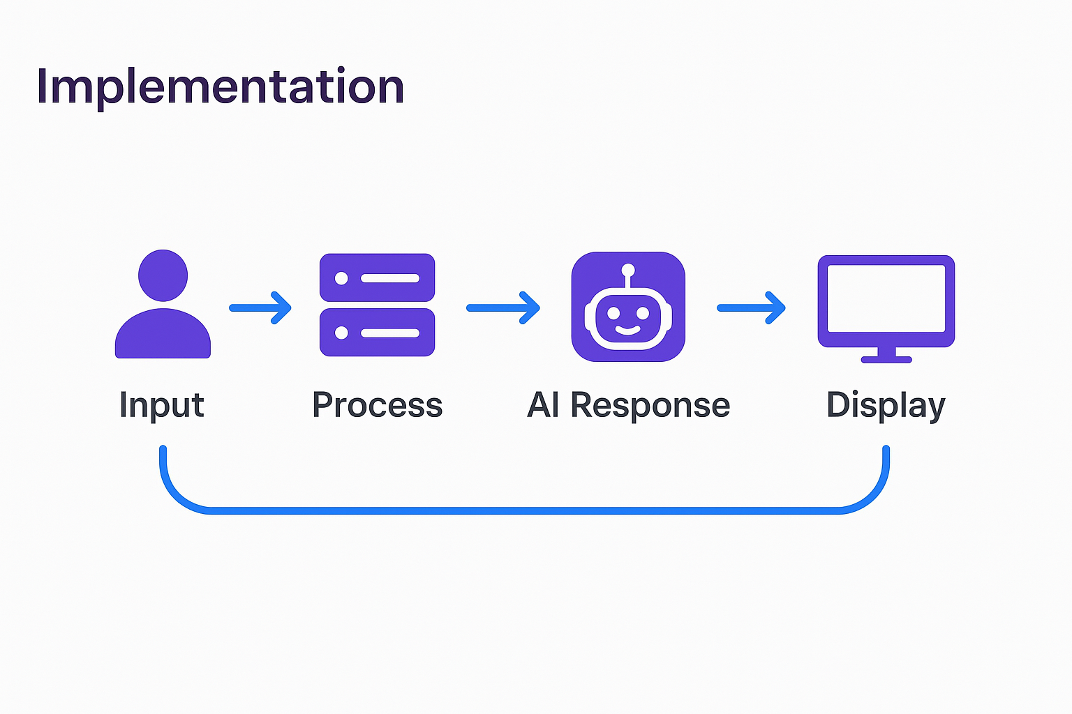
Implementation
Modules:
Login: Secure access control.
Chatbot: Real-time NLP interaction.
API Integration: Mistral-powered responses.
Content Generation: Summaries & reports.
Workflow: Input -> Process -> AI Response -> Display.

Slide 9
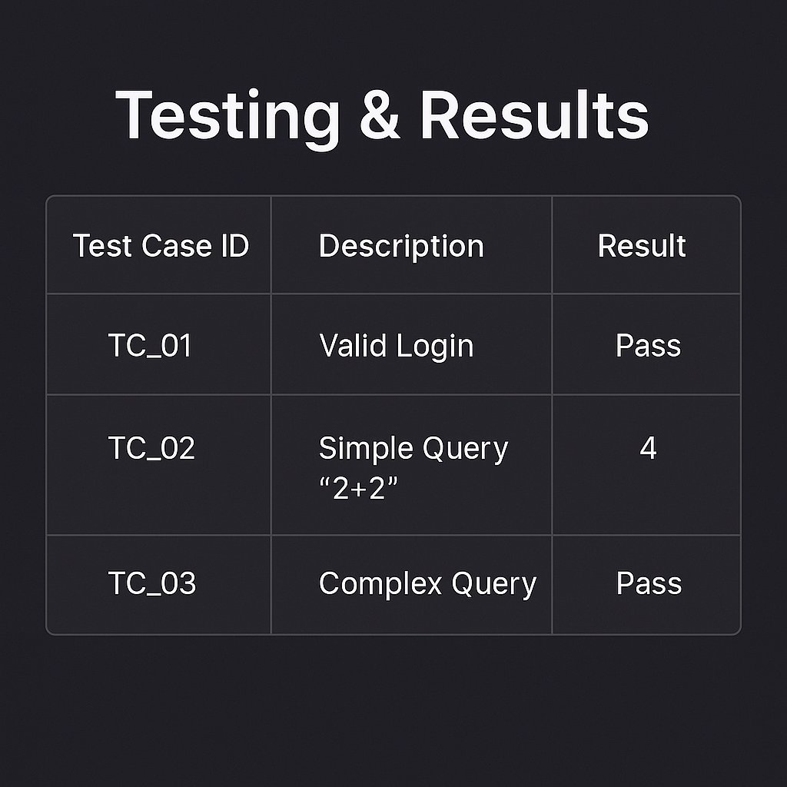
Testing & Results
Testing: Unit, Integration, Functional.
Test Cases:
"Valid login" -> Pass.
"Simple query (2+2)" -> "4".
Results:
95% test success rate.
1.5-sec response time for 50 users.

Slide 10
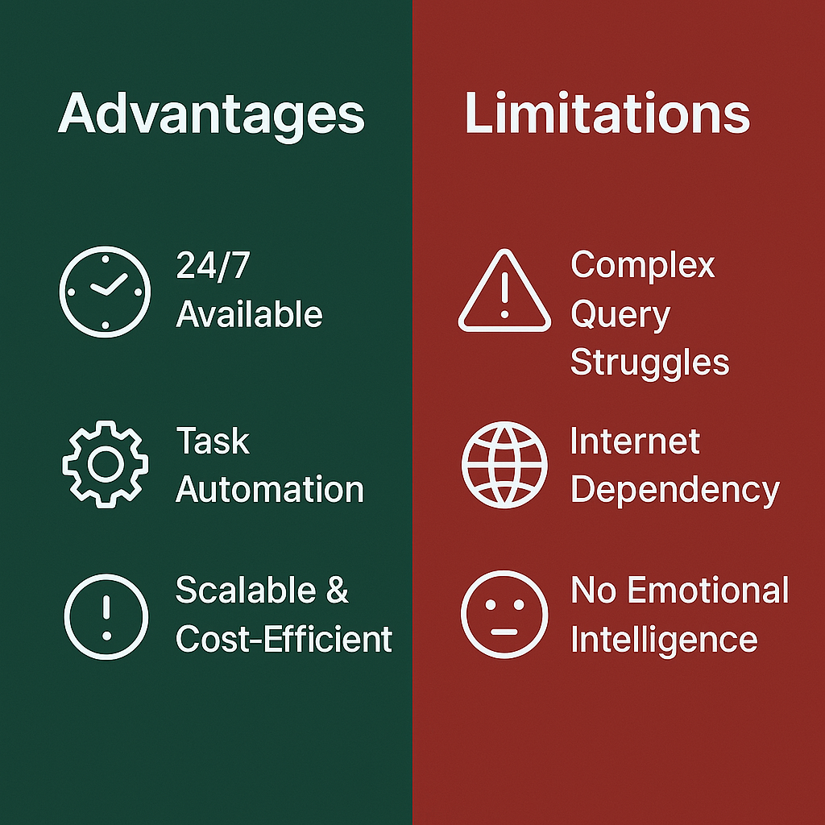
Advantages & Limitations
Advantages:
24/7 availability.
Task automation.
Scalable & cost-efficient.
Limitations:
Complex query struggles.
Internet dependency.
No emotional intelligence.

Slide 11
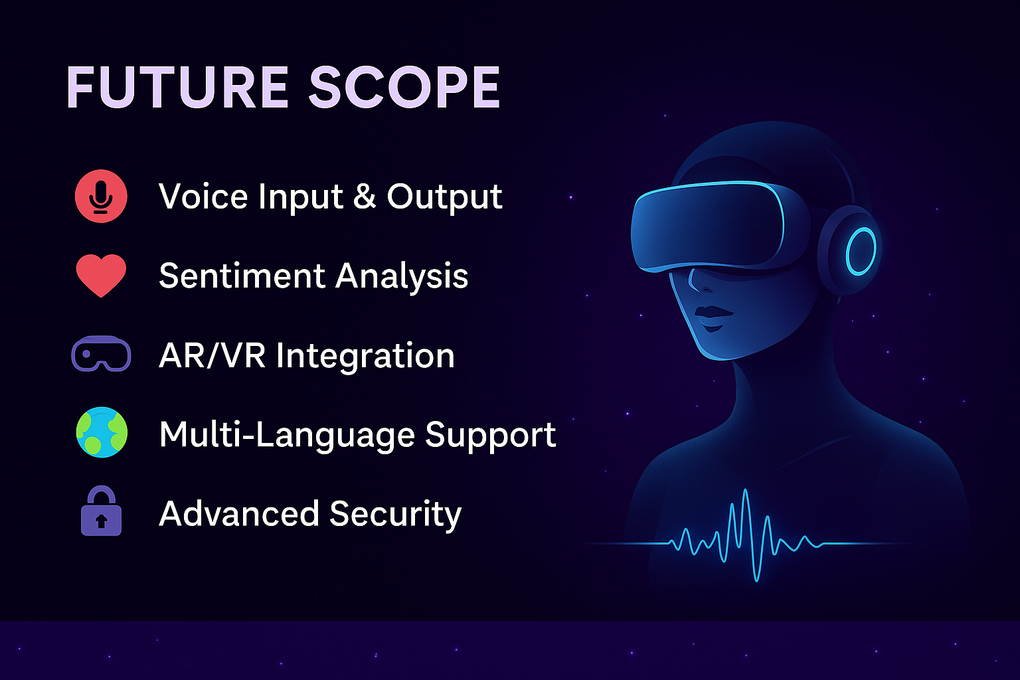
Future Scope
Voice input/output for hands-free use.
Emotional intelligence (sentiment analysis).
AR/VR integration for immersive help.
Multilingual support & advanced security.

Slide 12
Conclusion
A smart, practical assistant for today’s needs.
Learned: Python, APIs, UI design, testing.
Challenges: Privacy, complex queries—fixable!
Next Steps: More features, broader impact.

Slide 13
Thank You!
Adyaprana Pradhan
Roll No: 2275104

